Slide 1
Characterization of the Immune Response to SARS COV-2 in COVID-19

Slide 2
BACKGROUND
On Dec 31 2019 the WHO country office in China was alerted to media reports of an outbreak of atypical pneumonia cases in Wuhan
Jan 9 2020 Chinese officials report that the cases are due to a novel coronavirus
Jan 11 WHO receives genetic sequencies of the novel coronavirus from Chinese officials
Jan 13 Thailand Reports the first lab confirmed case of novel coronavirus outside China
Jan 21 The United States confirms the first case, WHO confirms at least some human to human transmission
June 28 WHO declares a pandemic

Slide 3
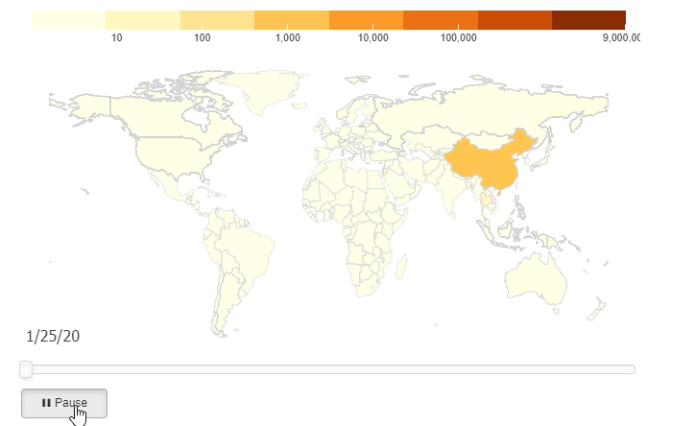
BACKGROUND

Slide 4
WHAT HAPPENED
Basic public health measures failed to keep the spread of this virus located to one region or country due to several complex issues:
Delayed identification of human-to-human transmission
Asymptomatic spread
An increasingly global economy and fast pace of travel across continents.
While some of the most low-tech and effective measures have failed there have been some successes:
Fast sequencing and publication of the genome of SARS-COV-2
Rapid work on the development of a vaccine and therapeutics

Slide 5
Our Study
A protein microarray containing 18 of the 28 predicted proteins from the SARS-COV-2 genome was constructed.
10 proteins were excluded as they could not be purified to an acceptable standard or obtained from commercial sources.
Sera from 28 patients who had convalesced from COVID- 19 were obtained on the day of their discharge.

Slide 6
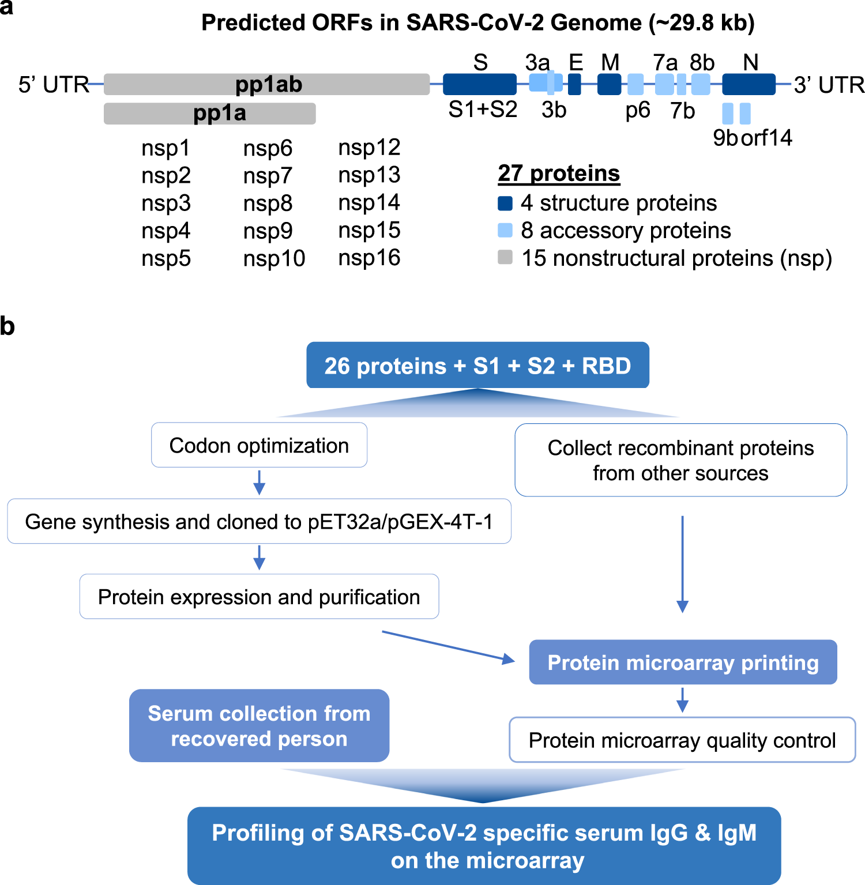

Slide 7
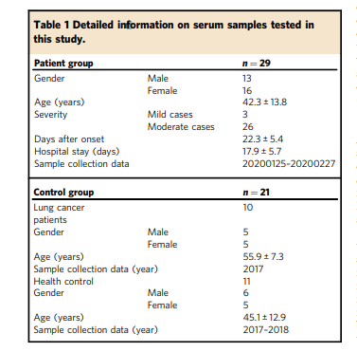

Slide 8
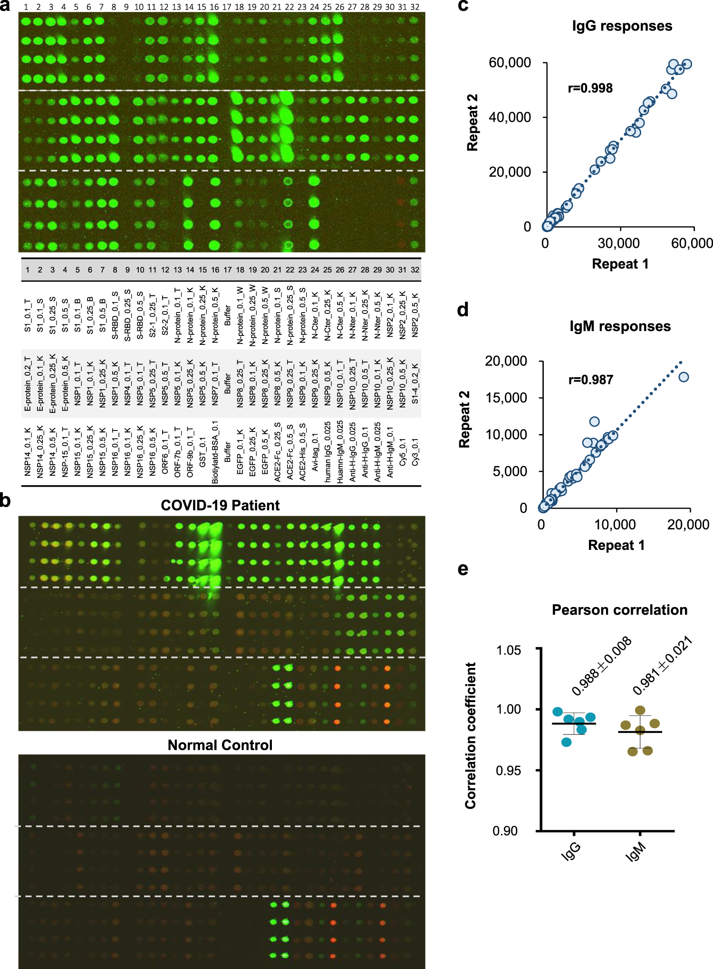

Slide 10
File Types

Slide 11
Troubleshooting -- maimages

Slide 12
Troubleshooting -- edgeR

Slide 13
Correspondence with the Authors

Slide 14
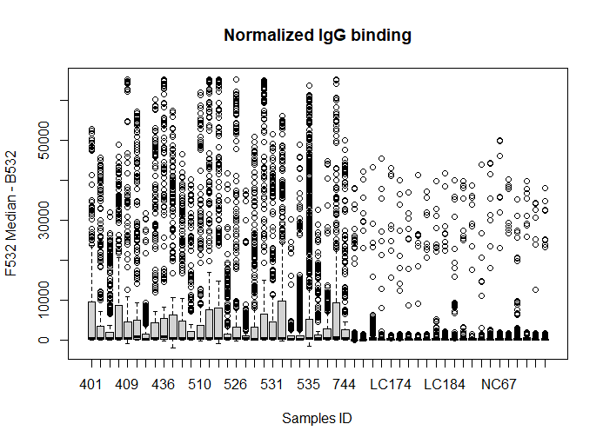
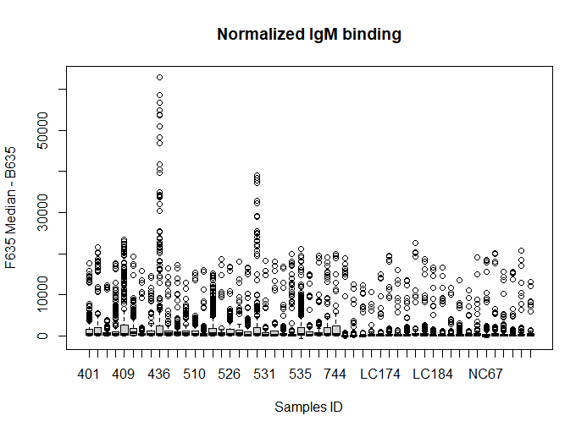
Analysis

Slide 15
Our Findings
While we were limited in out reanylsis of the data as described above.
We are able to show clear difference between the degree of IgG and IgM response demonstrated.
When we look at the methods for collection sera for COVID patients, sera was obtained at discharge:
discharge criteria are: (1) Body temperature is back to normal for more than three days; (2) Respiratory symptoms improve obviously; (3) Pulmonary imaging shows obvious absorption of inflammation; (4) Nuclei acid tests negative twice consecutively on respiratory tract samples such as sputum and nasopharyngeal swabs (sampling interval being at least 24 h)

Slide 17
Results
IgG responses against S1 protein were positively correlated with peak lactate dehydrogenase levels and inversely correlated with percentage of lymphocyte, finding which tend to correlate with the severity of illness.
For two of the control sera, strong IgG bindings were observed for N protein.

Slide 18
Opportunities for Further Work
Vaccines:
Immune response to possible vaccine candidate could be characterized in a similar manner and compared to the ummine response to patients in this study.
Therapeutics:
This study suggests that certain antibodies are present aty greater prevalence in the sera of convolecent patients these antibodies or a cocktail there of may represent possible therapeutics
Testing:
This study could be used to identify targets for antibody testing as the differences in the binding from convalescent and normal control serum suggests relative sensitivity and specificity for various targets

Slide 19
References

